Slide 1


International Community Projects
Aldo Donetti
Senior Program Manager
Cloud+AI International
aldod@microsoft.com
Twitter: @aldod

Slide 2
Agenda
Open Source (OSS) International Community Projects
International Community Contributions to Docs (docs.microsoft.com)
Get your Community involved
Q&A
Notes:
You will have noticed the emphasis on Community …

Slide 3
Open Source is a Community thing
Everyone loves free tools, hence everyone loves Open Source
Open Source projects are based on Communities by definition
The Community contributes to the Software/code
Not everyone speaks English - OSS projects get translated so that everyone can benefit from them.
The Community contributes to the Translation (Crowd-sourcing model)

Slide 4



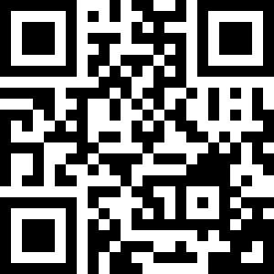
OSS Int.l Community Projects
SQL on Linux
SQL Ops Studio
Team Explorer
Everywhere
VS Code
And many more …
Check https://aka.ms/msossloc
- how to join / contribute
- status updates

Slide 5
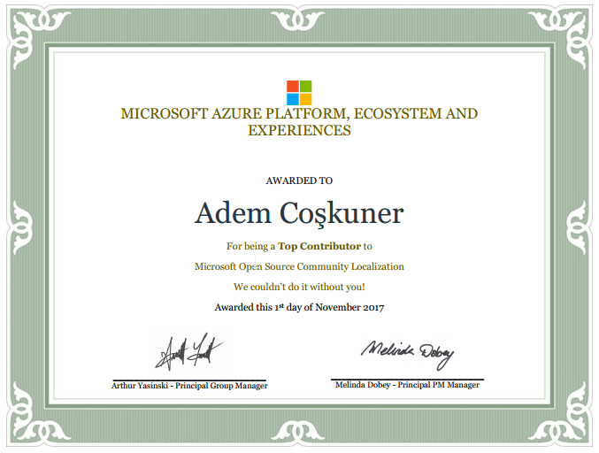







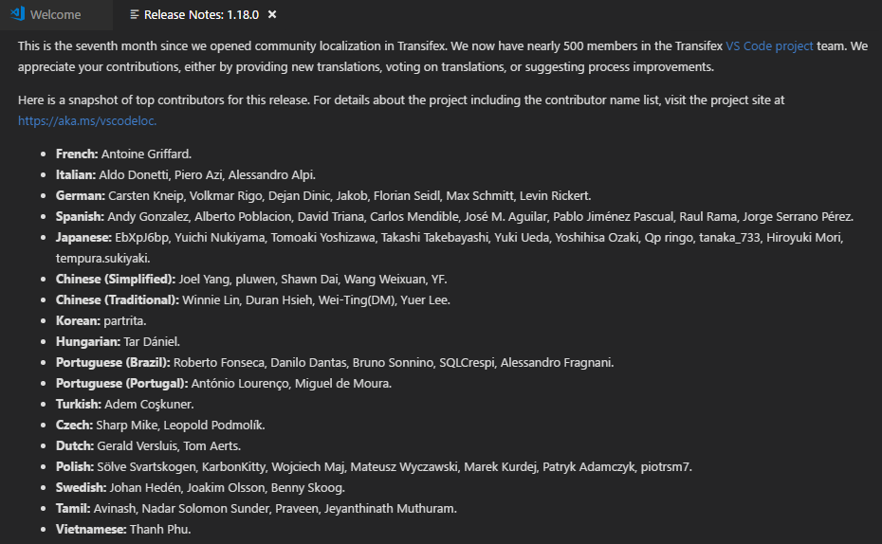
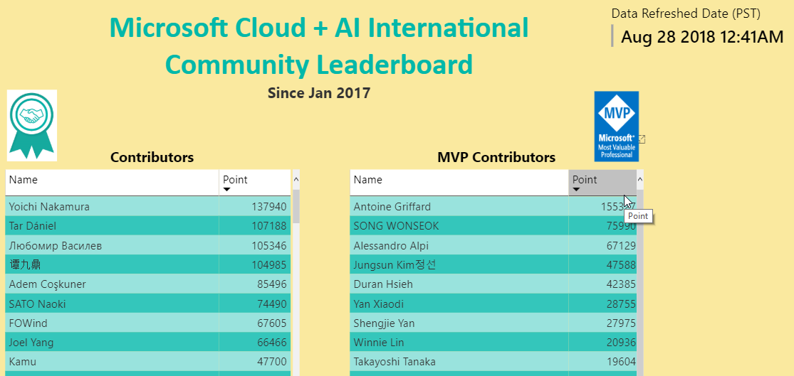
OSS Int.l Community – Status
1200+ members
Contributors are on the Leaderboard
https://microsoftl10n.github.io/
AND on the Products’ Release notes!
Certificates for top contributors
Calls with Engineering teams
Get updates
Twitter: @MicrosoftL10n
Social channels
https://aka.ms/msossloc
17+ langs
22 requested
3+ Mil downloads
Notes:
https://marketplace.visualstudio.com/search?target=VSCode&category=Language%20Packs&sortBy=Downloads
#As of End of August 2018
Chinese (Simplified): 1,617,093
Japanese: 482,672
Spanish: 366,223
German: 339,434
French: 224,872
Russian: 202,728
Portuguese (Brazil): 181,286
Korean: 139,474
Chinese (Traditional): 117,343
Italian: 85,767
Turkish: 25,549
Hungarian: 8,512
Bulgarian: 1,749

Slide 6
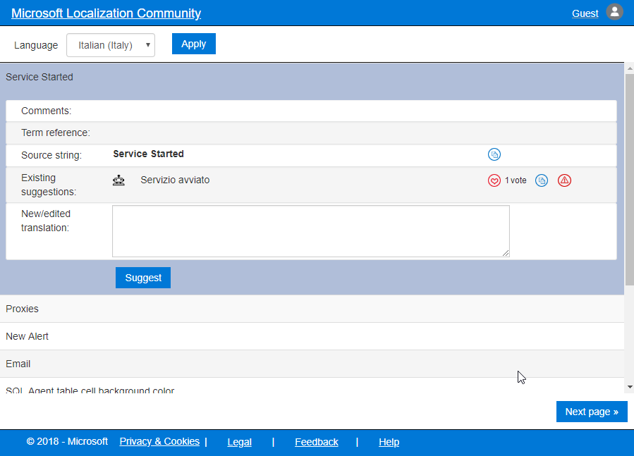
MLCP Demo
https://envelope-community.azurewebsites.net

Slide 7
Docs can be a Community thing
It’s just so much harder to be productive without good documentation ☹
Companies provide docs for products/services …
… we provide great documentation on docs.ms.com …
… but how much better could it be, if docs were Open Sourced and were improved by the Community?
Not everyone speaks English → Microsoft translates the Docs (millions of them!)
The Community can contribute to improve the overall quality of the content and of our Machine Learning/Machine Translation engines

Slide 8
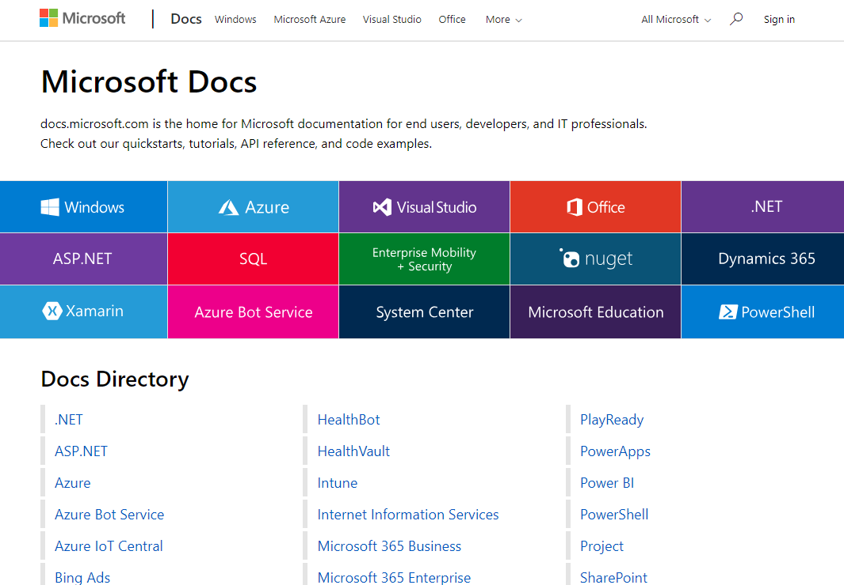
Docs - the «New Hope» for Technical Content
https://docs.microsoft.com
Key Principles:
Great Content
Modern/fresh UI
Standard Formats & Tools
Agile publishing
Community-enabled
Global by default

Slide 9
Docs – in detail
Content:
Re-engineered
More Samples
Quickstarts & Tutorials
stored in GitHub / Markdown format
Backend:
Runs on Azure
Highly automated single-article publishing
also uses BOTs for process management
Frontend:
Completely redesigned / Responsive UI
Feature-rich
New & Contextual Search
API Browser w/ versioning
Integrated CLI
Community-enabled (Editing/Feedback)
Global by Design
in 67 Languages
Hover-over (MT) / Read in English

Slide 10
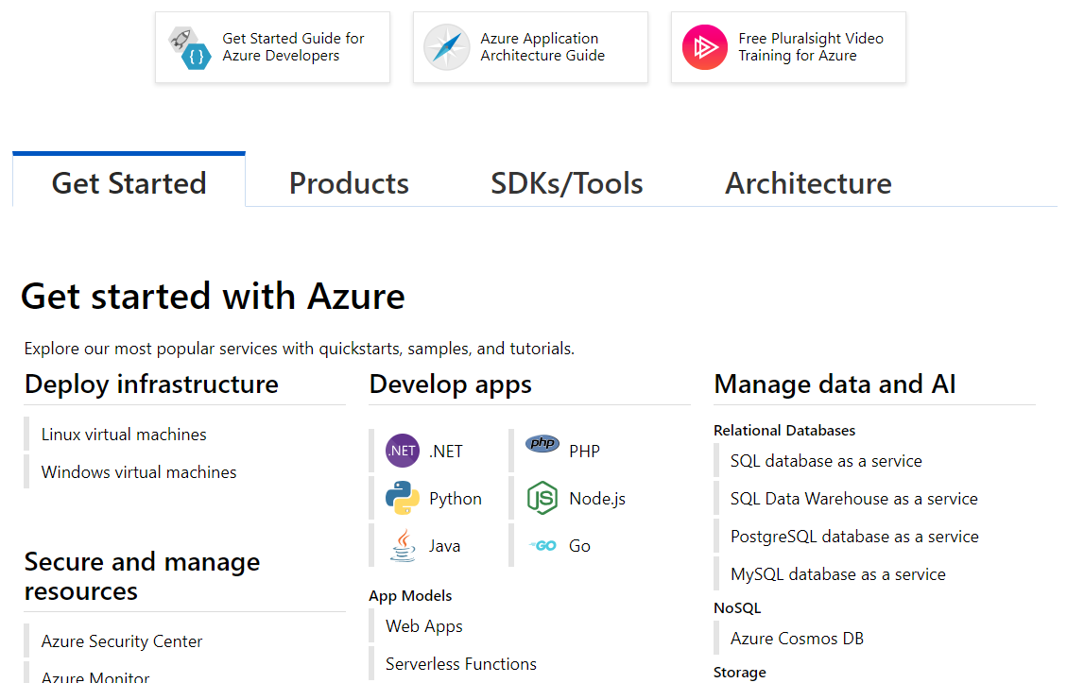
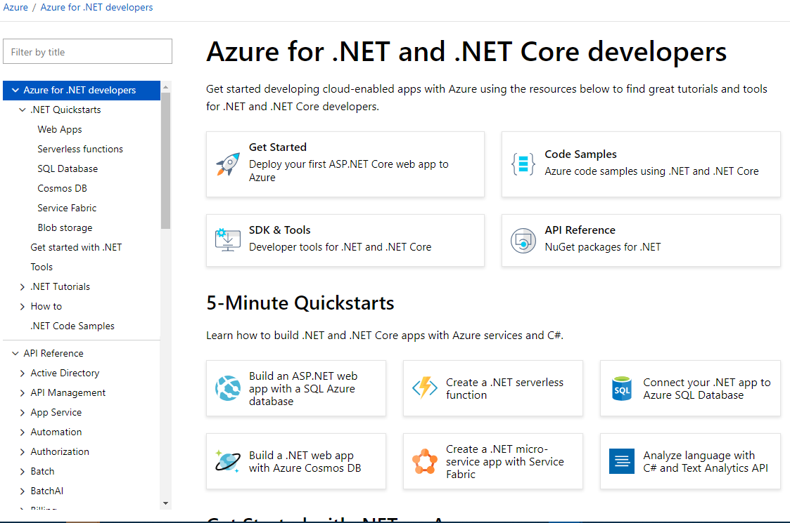
Redesigned site …

Slide 11
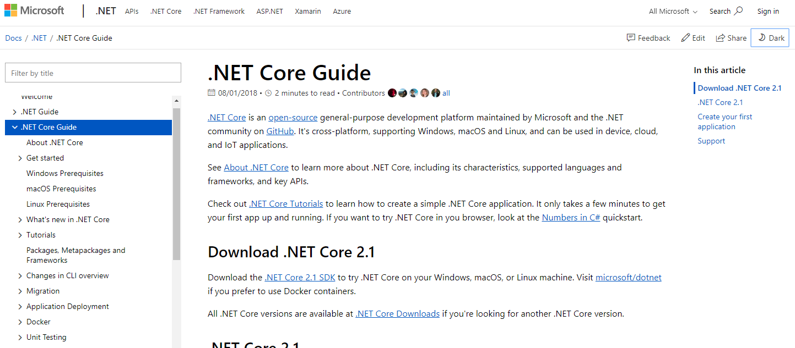
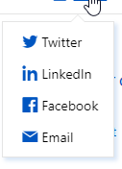
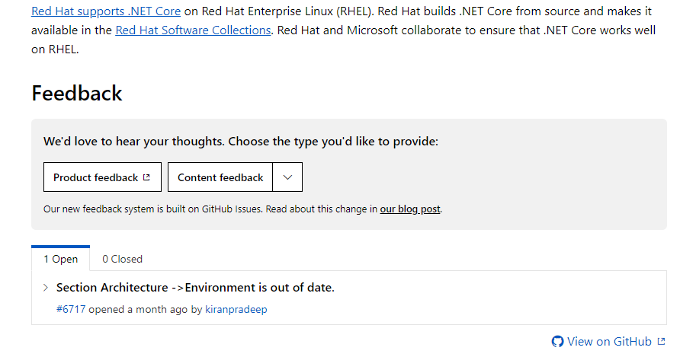
… and content

Slide 12
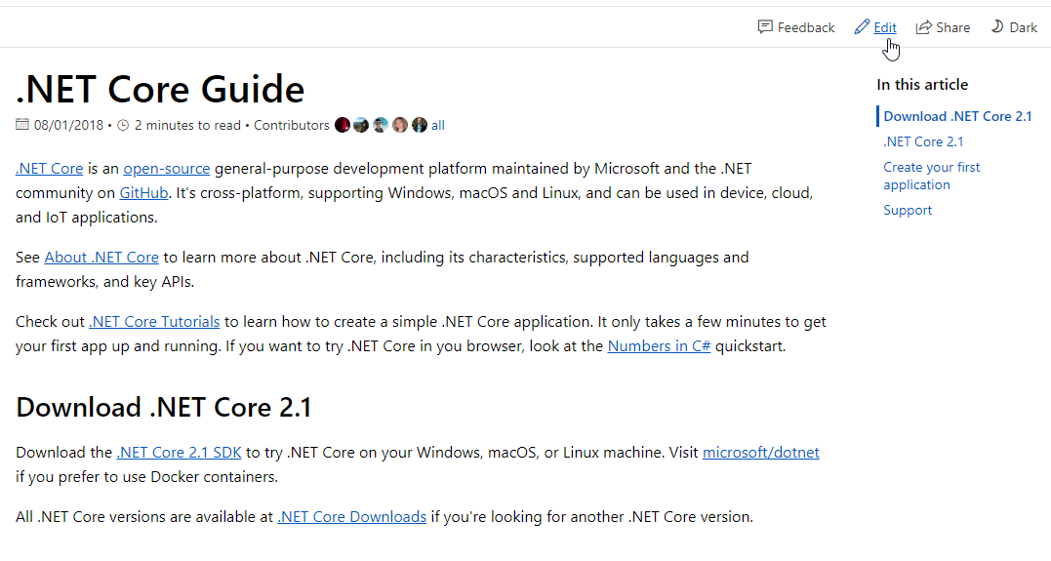
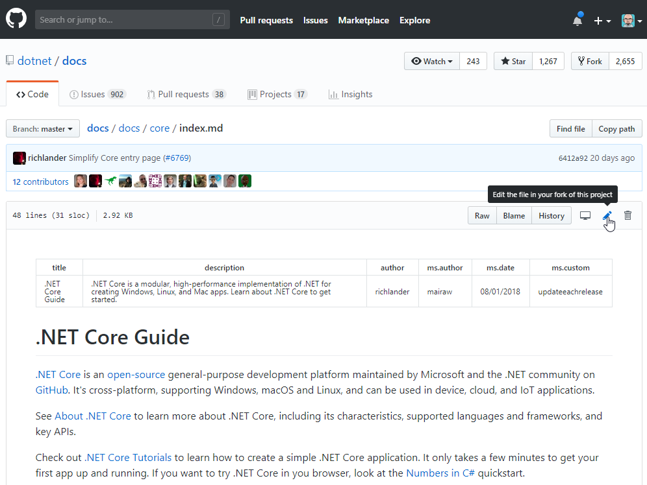
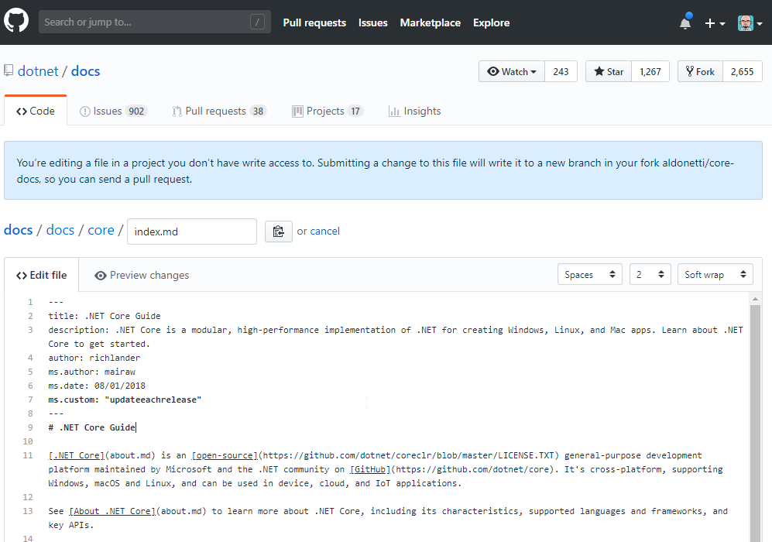
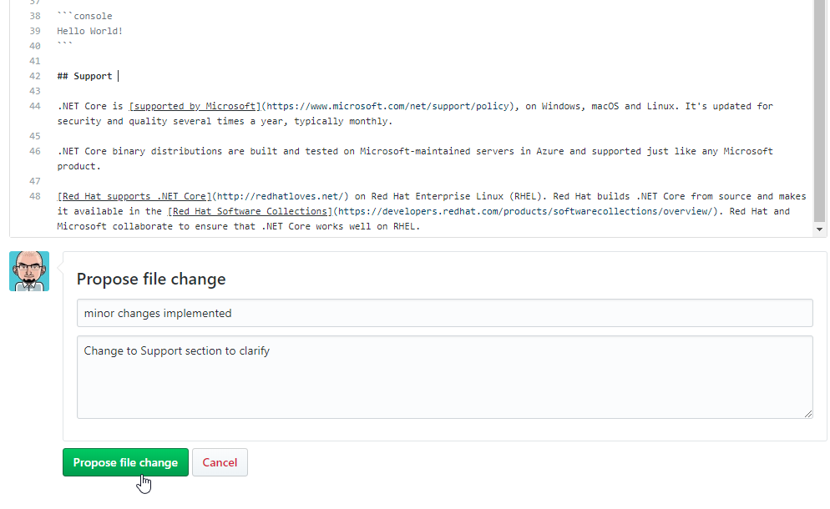
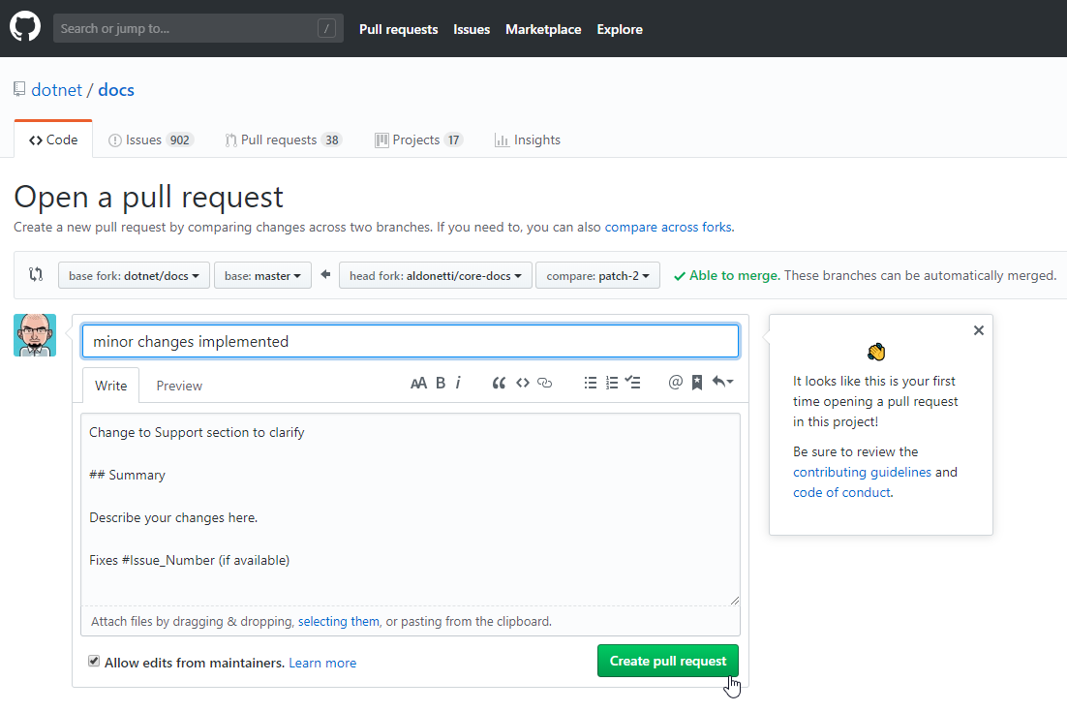
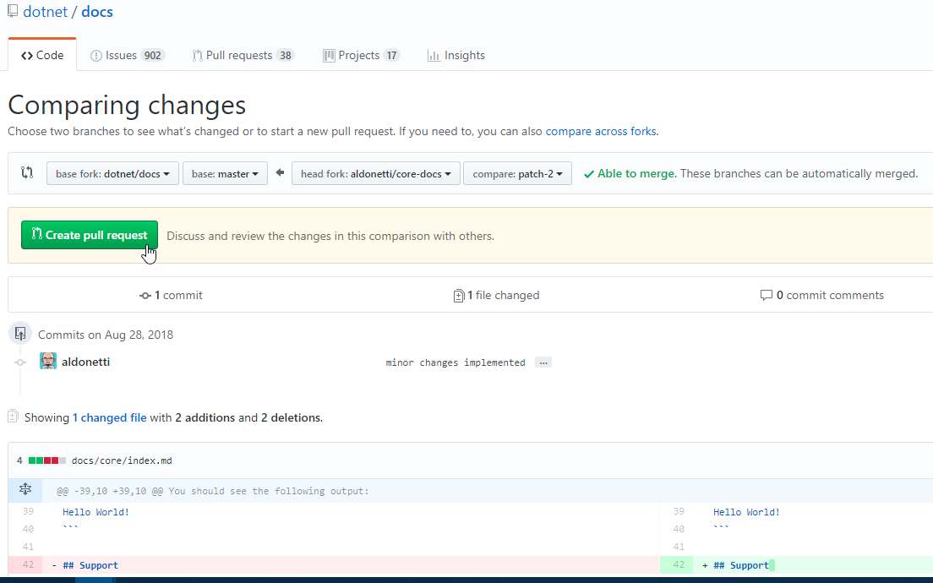
Contribution/Editing experience
Notes:
https://docs.microsoft.com/en-us/dotnet/core/

Slide 13
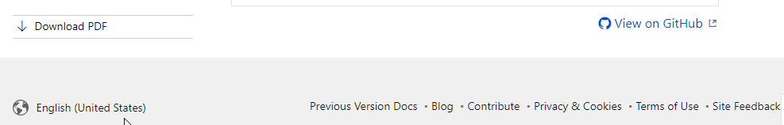
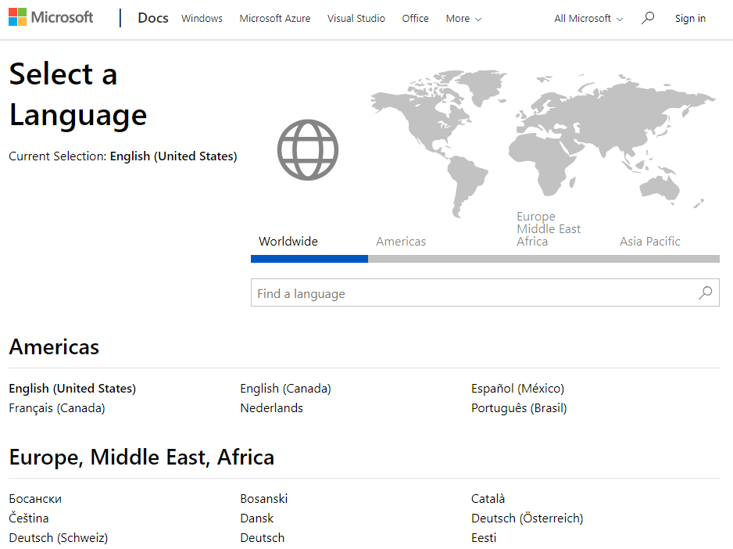
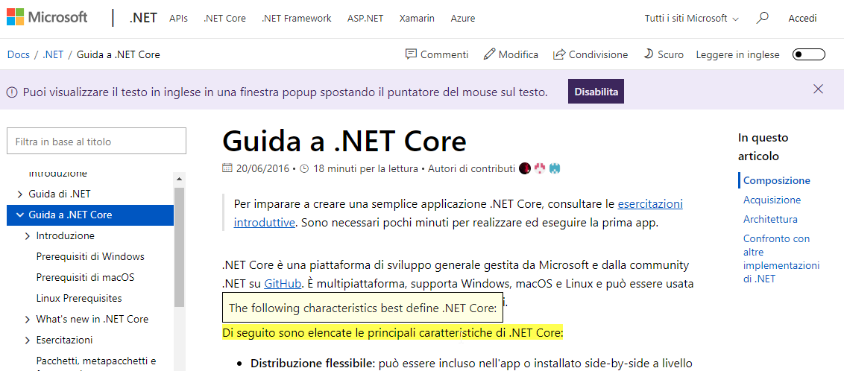
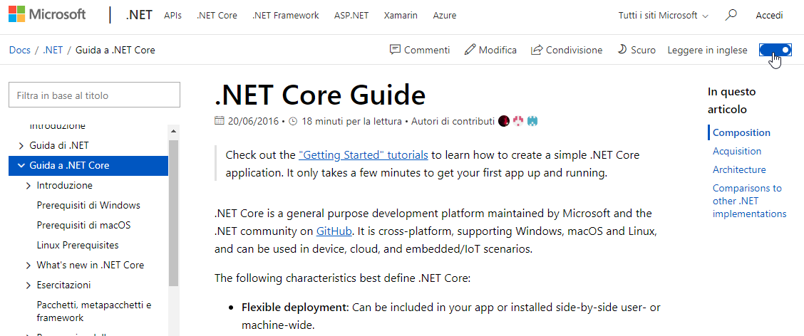
Global by default
Notes:
67 languages if we include Dynamics’ docs

Slide 14
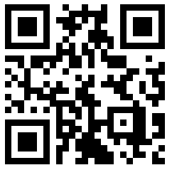
Get your Community involved
If you have a great article that covers areas that are not addressed in the official documentation, please feel free to submit it by entering a new Issue in GitHub. Our Technical Writers do listen!
You can suggest changes both on English or localized docs – in both cases you can make an impact worldwide!
Give us feedback on the platform as well
https://github.com/MicrosoftDocs/feedback/issues or @docsmsft
Help us spread the word within your communities!
https://aka.ms/intldocs
NOTE: contributions count against MVP status
Notes:
Today we have a vendor that monitors all languages – tomorrow we may need trusted moderators

Slide 15
Appendix

Slide 16
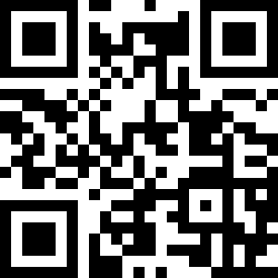

Where are the instructions? https://aka.ms/ms-docs
Docs.microsoft.com is new the platform hosting Microsoft technical documentation. Content is Open Source(*), Hosted on GitHub, Community-enabled + in your own language!
Help the Community improve Docs, and grow your reputation online!!
Discover how here https://aka.ms/intldocs
Do you like Open Source? https://aka.ms/msossloc
VS Code
SQL on Linux
SQL Ops Studio
in your language,
today!
Team Explorer Everywhere
… and more!

Slide 17
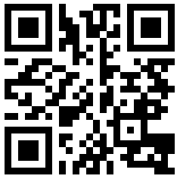
Where are the instructions? https://docs.microsoft.com
docs.microsoft.com is new the platform hosting Microsoft technical documentation
Content is Open Source(*), Hosted on GitHub, Community-enabled + in your own language!
So YOU can help the community of users Worldwide to get a better experience by improving the Docs, and grow your reputation online!!
Discover how here https://aka.ms/intldocs
Notes:
Core documentation includes: Reference material (w/interactive examples), Overview material, Quick Starts, Tutorials, Samples, How-Tos.
Soon: Cross-Product Tutorials / Hands-on-Labs / Deployments to Azure

Slide 18
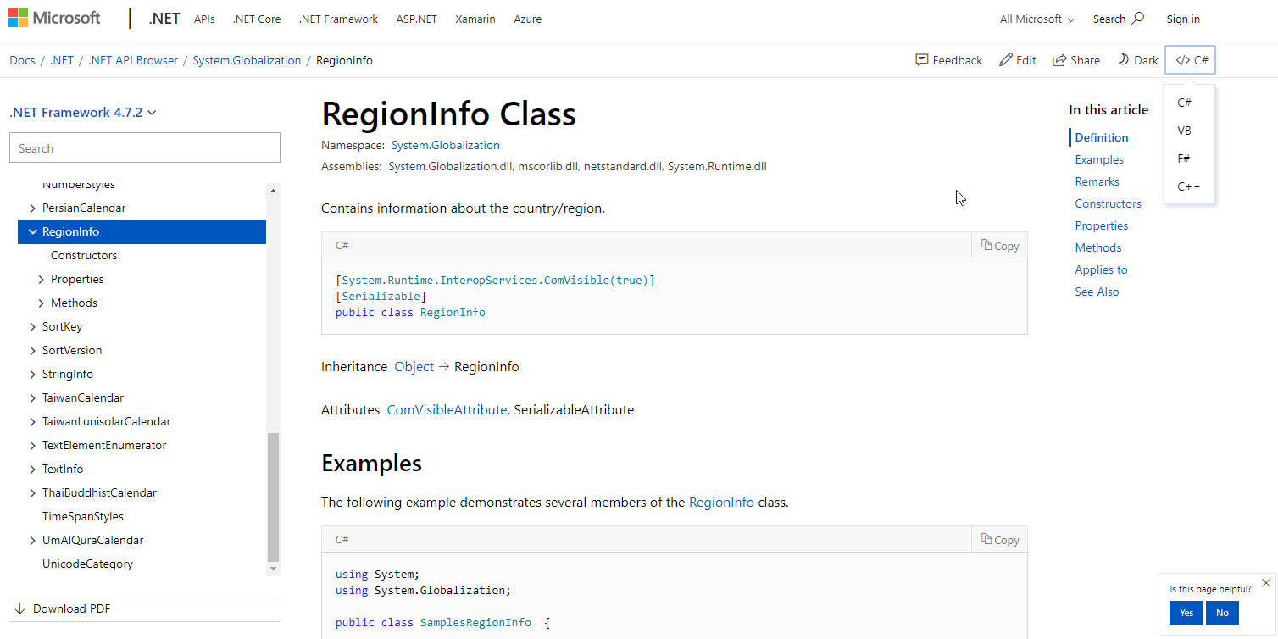
API Browser

Slide 19
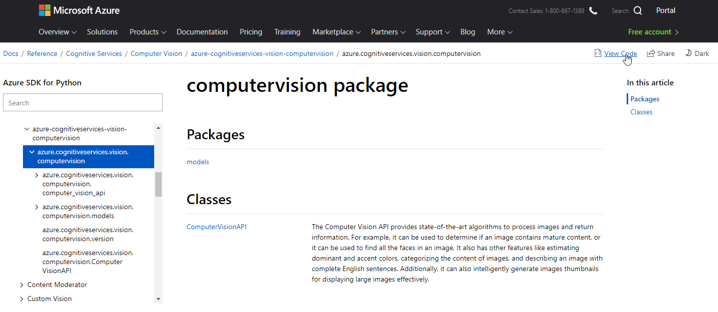
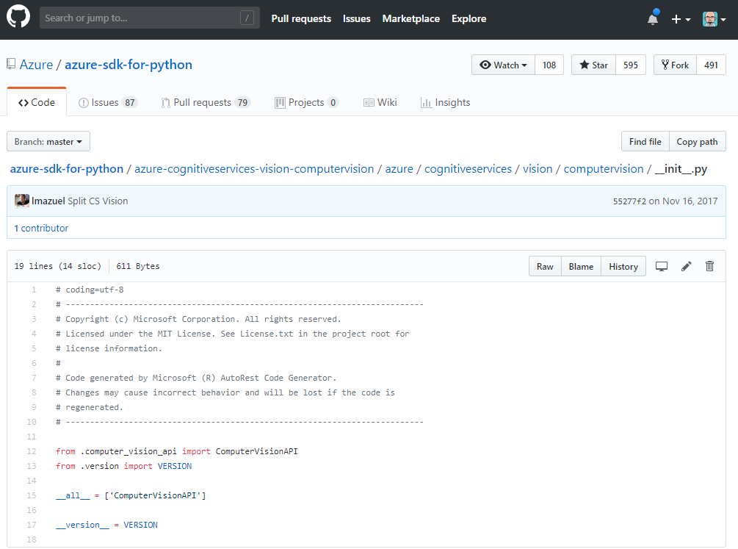
API Browser (cont.d)
Notes:
https://docs.microsoft.com/en-us/python/api/azure-cognitiveservices-vision-computervision/azure.cognitiveservices.vision.computervision?view=azure-python

Slide 20
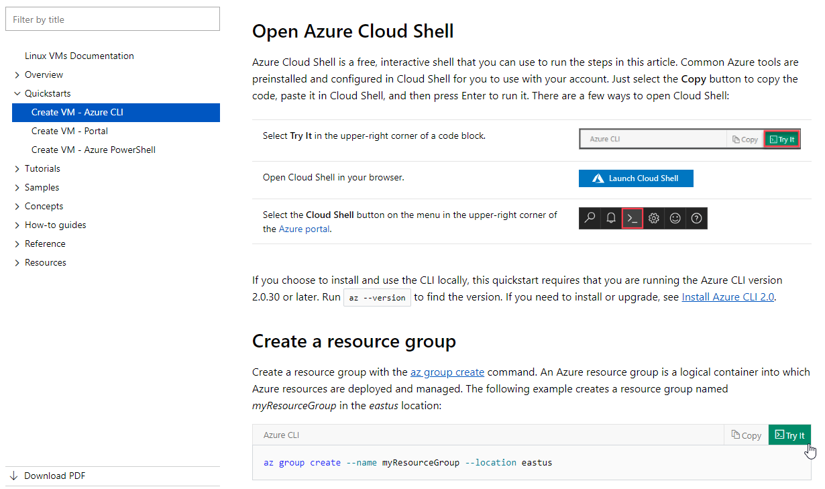
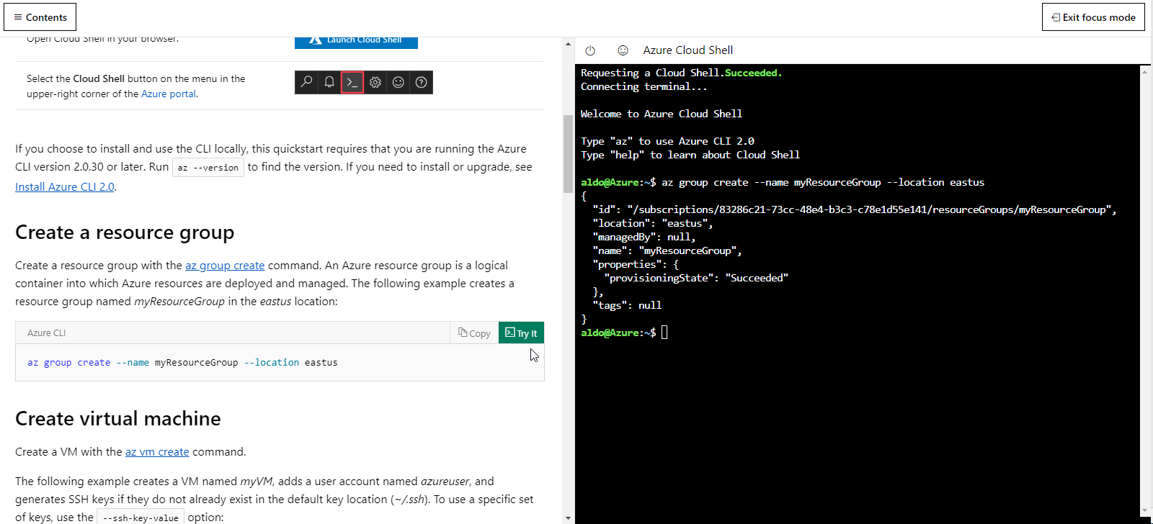
Integrated Cloud Shell

